Slide 1
AI-Opening Case Study
Artificial Intelligence Supporting Economic Re-Opening Efforts:
A Case Study Using Predictive Analytics for Risk Profiling of Covid-19 Patients
By: Erin Cao, Bo Chen, Qingyue Su, Peihan Tian, Kaihang Zhao, Jiujun Zhang

Slide 2

Overview
of Data
350,633 cases in total
6 age group indicators
1 gender indicator
229 DGL_3_Extend variables

Slide 3
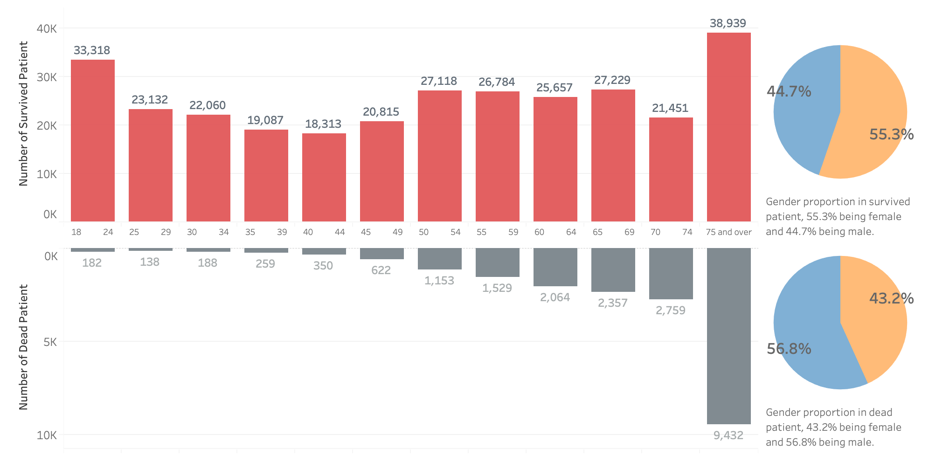
Survived Cases vs. Dead Cases

Slide 4

Most common DGL_3_Extend among survived patients
GENRL_UNSP_Other_Nos_A
GENRL_UNSP_Other_Nos_B

Slide 5
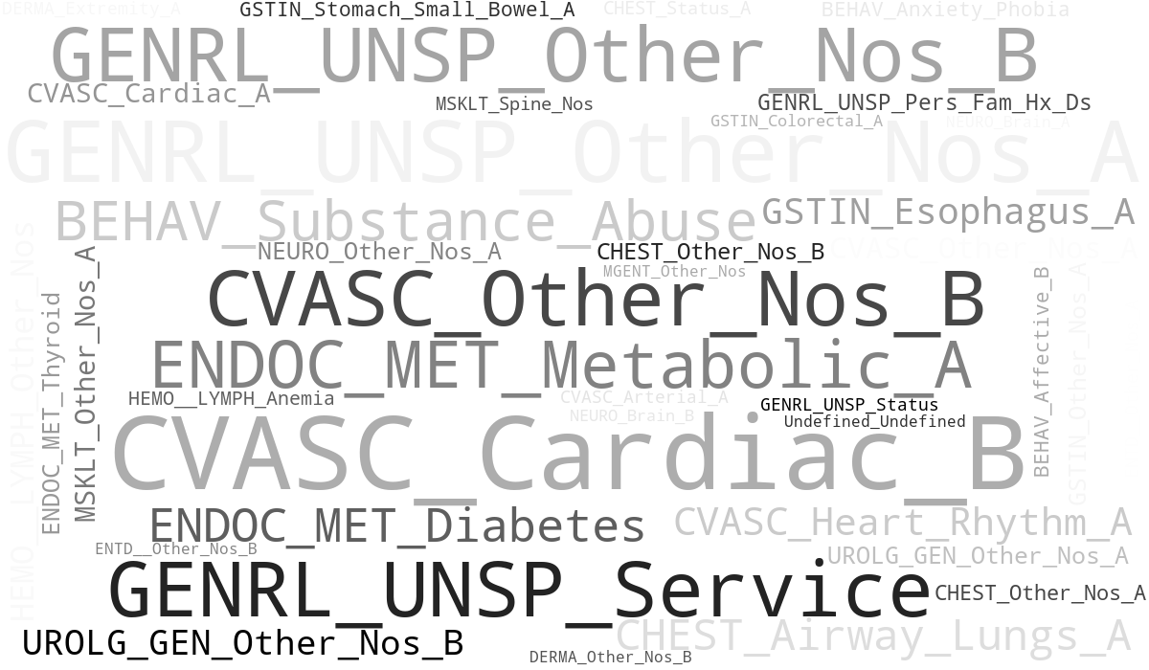
Most common DGL_3_Extend among dead patients
CVASC_Cardiac_B
GENRL_UNSP_Service
CVASC_Other_Nos_B

Slide 6
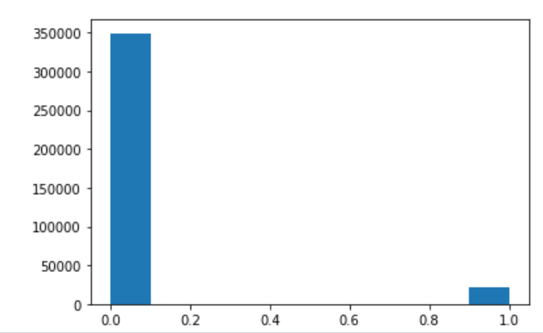
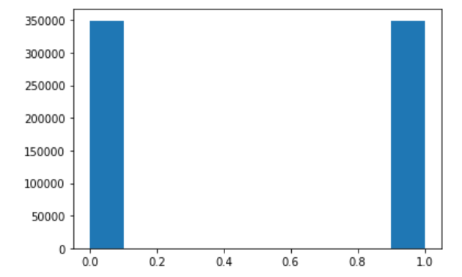
Data Preparation
Map Age and Sex variables
Map health condition variables to DGL_3_Extend
Create dummies
Oversample records where Mortality = 1

Slide 7
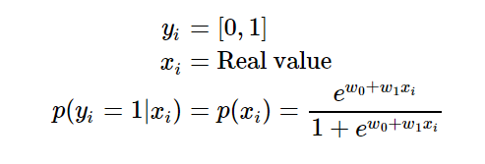
Logistic Regression
General idea:
Y= mortality X=236 independent variables
Train data size: 0.8, test data size:0.2
Confusion Matrix:
Accuracy: 0.94056
 | Diagnosed Dead | Diagnosed Alive
Dead | 65213 | 4305
Alive | 4002 | 66226

Slide 8
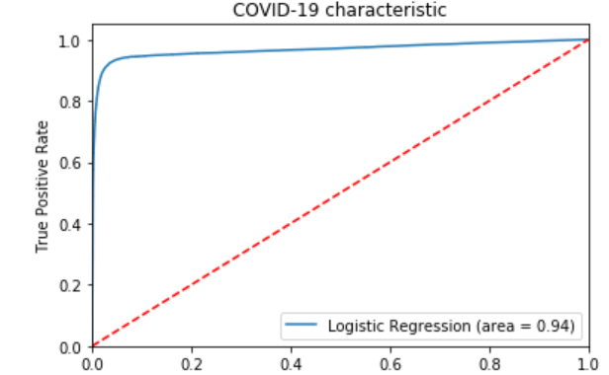
Logistic Regression
The blue line is our logistic regression ROC curve, which shows a line far away from the red line, which means that we have a model with relatively high performance.

Slide 9
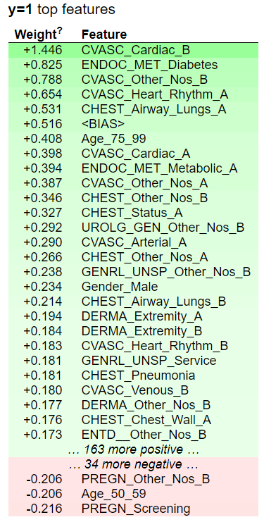
Feature importance generated by Logistic Regression
Top 30 important features
The number means the coefficient in front of each feature.
Most important: cardiac, diabetes, heart, lungs age 75-99.
General takeaway:
People with cardiac, diabetes, or lungs diseases are more vulnerable to
COVID-19 and they are most likely to pass away when they get infected with
COVID-19.

Slide 10
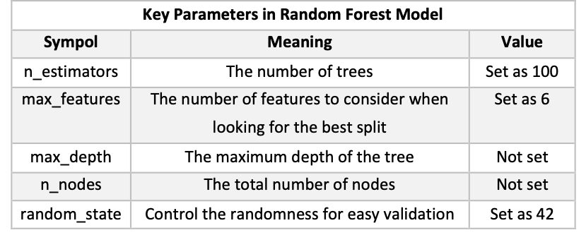
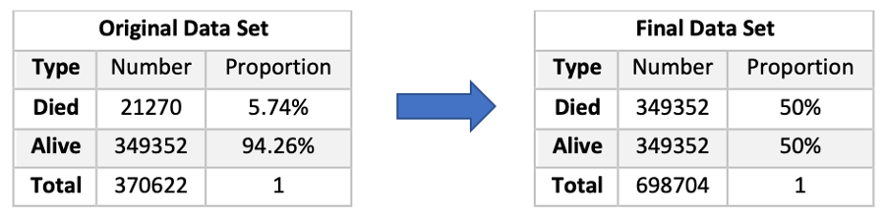

Random Forest
General Idea:
Y= mortality X=236 independent variables
Train data size: 0.7, test data size: 0.3
Accuracy: 0.975
A popular machine learning tool, which uses multiple trees to vote for the best classification as the final decision.

Slide 11
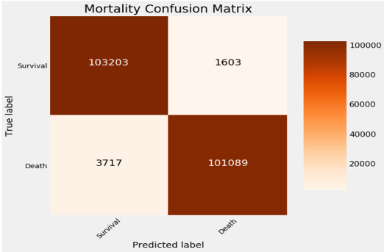
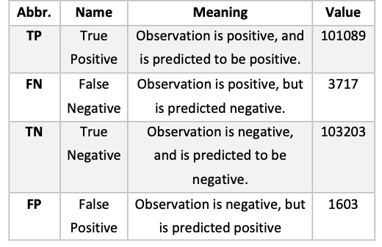
Random Forest
Confusion Matrix:

Slide 12
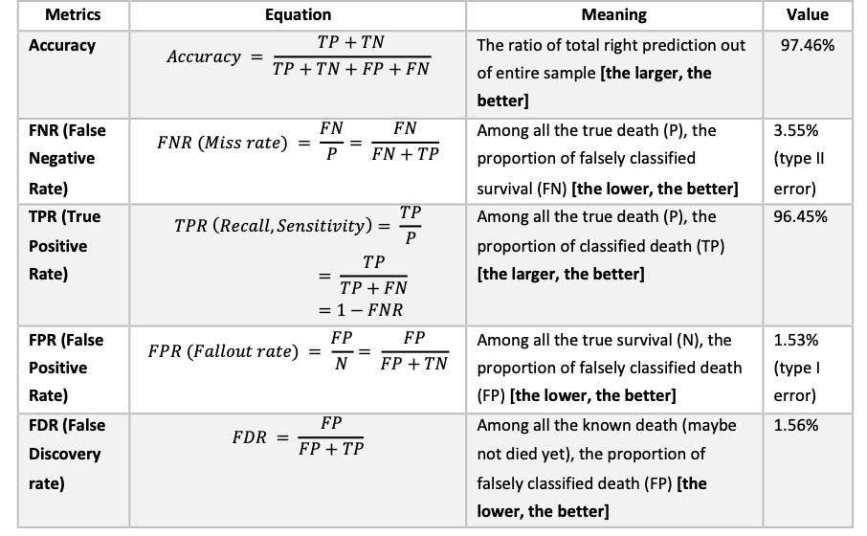
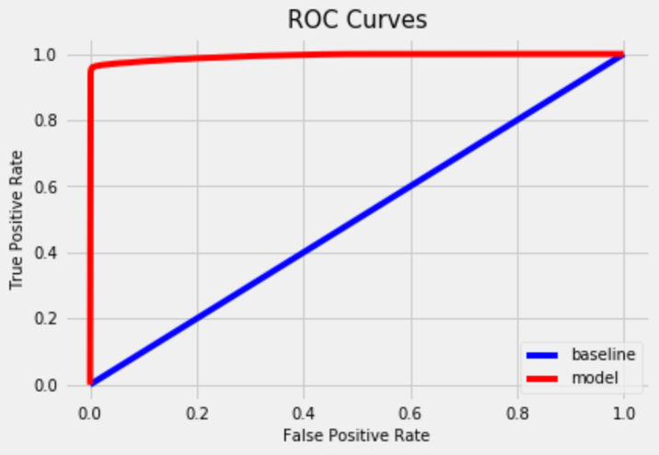
Random Forest
Confusion Matrix (Cont.):

Slide 13
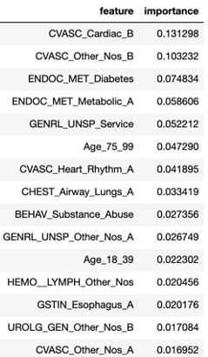
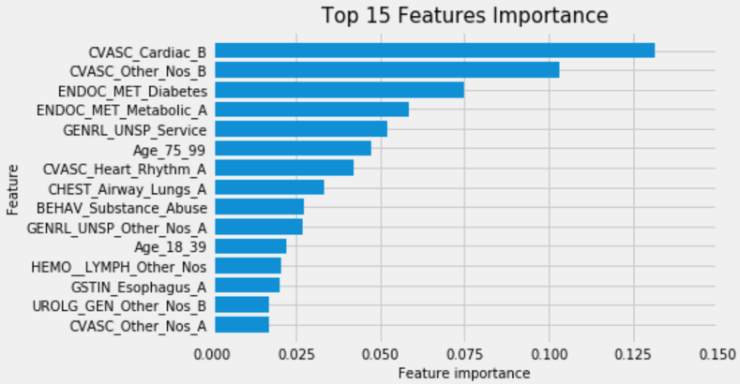
Feature Importance Generated by Random Forest
Top 15 important features:
Diseases: cardiovascular disease, endocrine disease (e.g.: diabetes), metabolic diseases, heart rhythm disturbances, airway diseases, substance abuse (e.g.: alcohol, drugs)
Aged: 75-99, 18-39
General takeaway: People who have these diseases or aged are more likely to be in higher risk when infected by COVID-19.

Slide 14
Gradient Boosting Classification Tree
General Idea:
Y= mortality X=236 independent variables
Train data size: 0.8, test data size: 0.2
Accuracy: 0.943
Confusion Matrix:
Gradient Boosting Tree builds the model in a stage-wise fashion like other boosting methods do, and it generalizes them by allowing optimization of an arbitrary differentiable loss function.
 | Predicted Live | Predicted Death
True Live | 82328(TN) | 4846(FP)
True Death | 5114(FN) | 82391(TP)

Slide 15
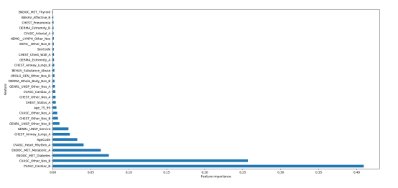
Feature Importance Generated by Boosting
Top 30 important features
The number means the coefficient in front of each feature.
Most important: Cardiac disease, heart disease complications, diabetes, metabolic diseases, heart rhythm disturbances
General takeaway:
People who have these diseases are more likely to be in higher risk when infected by COVID-19.

